Slide 1
The effect of access to internet on Health Insurance demand in India’s rural versus urban areas in a modern context Kasi Donepalli

Slide 2
Introduction
Out of pocket health spending is a significant factor driving around 6.2% of the Indian population below the poverty line(BPL) every year( Nandi et al.,2013).
Risk sharing mechanisms such as health insurances help families cover unexpected medical expenses without much burden on their out-of-pocket expenses. Lack of access to healthcare and unexpected health expenditures are argued to be one of the major causes of poverty in developing countries.
Lack of health insurance is believed to have a negative impact on the health of the household in general. As a consequence of ill health in developing countries, the skillset of human capital which is essential for a country’s economic growth is argued to be mediocre
However, in order to encourage subscriptions to health insurance programs, it is of paramount importance to understand the factors driving a population’s willingness to subscribe for health insurances.
There exists well-established literature on the effect of socio-economic and demographic variables on health insurance demand(Wan et al.,2020). However, the effect of access to internet devices on health insurance demand is still not well-established
It is crucial to study this association due to increasingly rapid mobile phones penetration and digitization of Insurance products delivery mechanisms in India

Slide 3
Literature review
Study-1 | Study-2 | Study-3
Wan et al.(2020) studied the determinants of private health insurance(PHI) acquisition in China. 4th wave of China Household Finance survey conducted in 2017 and used logistic regression this study employed Andersen health services utilization model Predisposing factors like age, level of education,marital status, size of household), enabling factors such as income of household, household medical expenses and debt), and need-based factors(major illnesses) were found statistically significant | Chakrabarti and Shankar.(2018) studied the effect of a household assets, exposure to media demographic and caste of households on health insurance use in India, by analysing the National Family Health Survey-III data Results of this study have shown that richer households are more likely to subscribe for health insurance and access to media has a positive correlation with HI subscription. Lower subscription rates are seen in the scheduled tribe groups in rural and urban areas as well, and the Muslim groups living in urban regions. | Nandi et al.(2013) studied the determinants of participation in Rashtriya Swasthya Bima Yojana(RSBY) at a district level By analysing the household survey 2007-2008, and an additional state-level information on fiscal health, political affiliations, and quality of governance. Used multivariate probit and OLS. The districts with lower quality of governance, were significantly less likely to participate. Districts with higher share of socioeconomically backward castes are less likely to participate.

Slide 4
Research question, expected hypothesis, & contribution
Research question: To study the effect of access to internet on health insurance demand in India’s rural verus urban areas.
Expected hypothesis: This study hypothesizes that a greater percentage of the Indian urban population have health insurance than the rural counterparts, and access to digital devices increases the likelihood of a person having health insurance.
Contribution: This study aims to contribute towards insurance policy making in a digitalized world by empirically determining the impact of consumer access to internet devices on health insurance demand amongst several other demographic, socio-economic and psychosocial variables, and ultimately, contribute towards achieving Universal health coverage.

Slide 5
Data
Variable | Code | Type | Description
Health Insurance status of a Household | HHealth_Ins | Binary | = 1 if a household has a government or private Health Insurance, else, 0, if neither.
Has access to Internet | Int_access | Binary | =1 if a household owns a computer or laptop or a mobile phone, else, 0, if neither.
Caste | caste | Categorical | =1 if General(Brahmin/ OBC/forward) =2 if Scheduled Caste(SC) =3 if Scheduled Tribe =4 if other castes
Religion | religion | Categorical | =1 if Hindu =2 if Muslim =3 if Christian =4 If others(Sikhs, Buddhism, Jainism,Tribal, others or none)
Urban Residence status | urban | Binary | =1 if household living in urban areas = 0 if living in rural
Faced major illness/accidents with large amounts of expenditure | major_illness | Binary | =1 if had a major illness/accident with large amounts of expenditure =0 if no
Household has some kind of financial security | fin_secure | Binary | =1 if a household has bought securities/fixed deposits/Bank savings/part of a credit society/post office account/gets pensions or has LIC = 0 if none above
Confidence in government hospitals and doctors to provide good care | conf_ghosp | Binary | =1 if confident = 0 if little to no confidence
Confidence in courts to deliver justice | conf_courts | Binary | =1 if confident = 0 if little to no confidence
Confidence in banks to keep money safe | conf_banks | Binary | =1 if confident = 0 if little to no confidence
Confidence in government to take care of its people | conf_gov | Binary | =1 if confident = 0 if little to no confidence
Age of male head in the household | head_age | Continuous | Age in numbers
Household had debt in the last five years | debt | Binary | =1 if had loans in the past 5 years, else, 0.
Highest adult education in the household | educ_level | Categorical | =0 if studied less than 10th standard =1 if studied 10th or 11th class =2 if studied 12th class or one year postsecondary =3 if studied more than or equal to 2 year post secondary or bachelors or advanced bachelors
Household Total Income | income | Continuous | Total Income of household
Number of people in a household | N_persons | Continuous | Number of individuals in a household
Interaction term(conf_gov*income) | conf_gov * income | conf_gov – Binary income-Continuous | Captures the additional effect of income on Health Insurance given that households are confident in the government to take care of them as opposed to non-confident groups

Slide 6
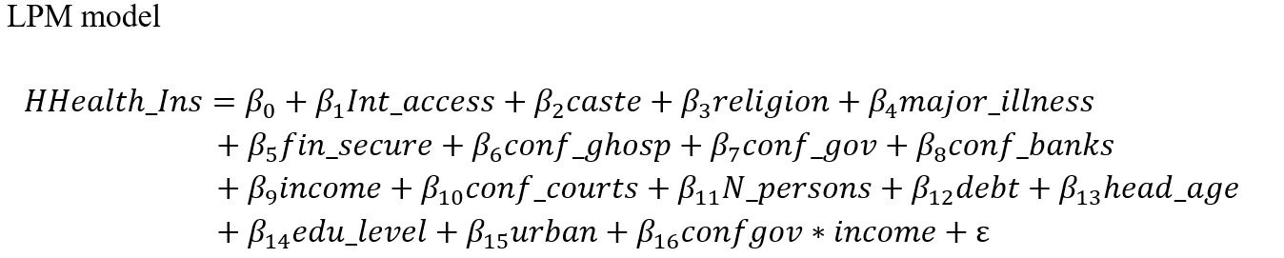
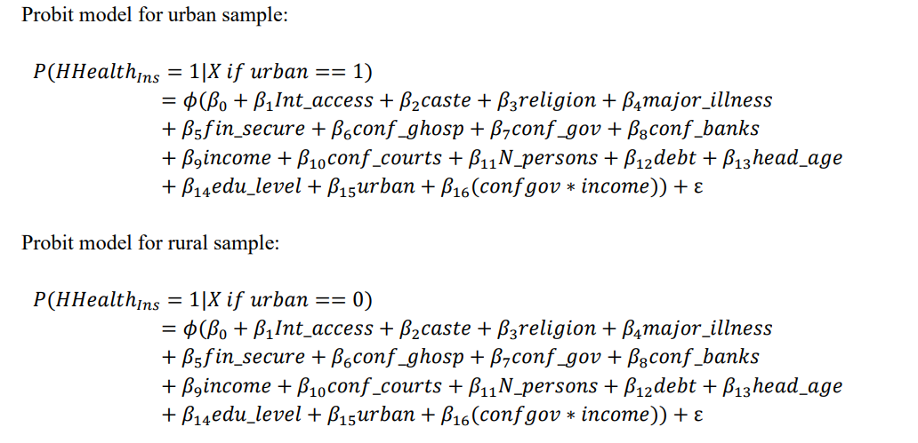
Data summary statistics and empirical model
Variable | Type | Mean | N | Std Dev | min | max
HHealth_Ins | Binary | 0.10 | 41700 | 0.31 | 0 | 1
Int_access | Binary | 0.80 | 41669 | 0.4 | 0 | 1
caste | Categorical | 1.43 | 41614 | 0.7 | 0 | 3
religion | Categorical | 1.29 | 41699 | 0.70 | 0 | 3
urban | Binary | 0.35 | 41700 | 0.48 | 0 | 1
major_illness | Binary | 0.26 | 41621 | 0.44 | 0 | 1
fin_secure | Binary | 0.99 | 27241 | 0.09 | 0 | 1
conf_ghosp | Binary | 0.54 | 41619 | 0.5 | 0 | 1
conf_courts | Binary | 0.67 | 41490 | 0.47 | 0 | 1
conf_banks | Binary | 0.90 | 41566 | 0.3 | 0 | 1
conf_gov | Binary | 0.3 | 41497 | 0.46 | 0 | 1
head_age | Continuous | 49.1 | 35865 | 13.5 | 15 | 99
debt | Binary | 0.53 | 41672 | 0.5 | 0 | 1
educ_level | Categorical | 0.96 | 41689 | 1.2 | 0 | 3
income | Continuous | 129469.6 | 41700 | 217085.5 | 0 | 1.14 x 10^7
N_persons | Continuous | 4.85 | 41700 | 2.32 | 1 | 33

Slide 7
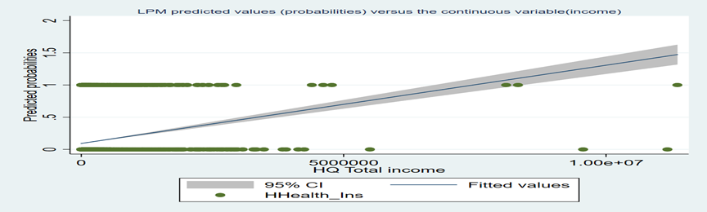
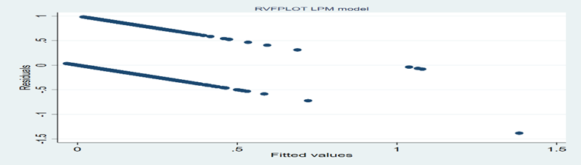
Results- LPM and Issues with LPM

Slide 8
Probit sub-sample marginal effects at means

Slide 9
Conclusion and Discussion
Found that access to Internet is positively associated with increased Health Insurance uptake both in rural and urban areas. Though, in urban areas, Probit marginal effects at means suggests that Int_access is a statistically insignificant variable.
The Probit results in comparison to the benchmark OLS regression are almost similar, both models identify positive relationship between Int_access and HI uptake , however, since LPM predicted probabilities range beyond [0,1], the LPM estimates are inaccurate.
The results of this study are in line with literature such as Supakankunti.(2001) and Alesane and Anang.(2018) as the results of this study also find that age, education levels and household size as significant variables. Also, with increase in household size our results indicate a lower likelihood of HI uptake which is aligned with the same reported result in Supakankunti.(2001).
In concern to the effect of Muslim households, this study found that urban households are 5.4% less likely to take HI as opposed to Hindu households, and this result is in tandem with the same findings in the works of Chakrabarti and Shankar.(2018), and at the same time, caste and religion were found to be significant determinants of Health Insurance uptake in our study as well.

Slide 10
Conclusions and Discussions
This study has made an inherent assumption that households with computers, mobiles and laptops are connected to Internet as well, because IHDS-II survey data did not have a direct variable for households with Internet access. However, this assumption could have had spill over effects on to the reliability of our results
There was a rapid rise in Internet users in India in the past few years. Statistics suggest that there were only 125.9 million internet users in India during the year 2011 and whereas, in 2020 there were 749.07 million users(Basuroy,2022).
Could not identify if IV-Probit and bi-probit model were needed for the purposes of my study. However, in the future the basic Probit model used in this study can be built on further.
Recommends policy makers to consider the enormous influence of Internet and education (especially, greater than 12th standard) on Health Insurance uptake and therefore, design policies to digitally promote Insurance campaigns and expedite the process of online insurance delivery systems.
Highlights the disparities in Insurance uptake between religions and castes in India, hence, it is imperative for policymakers to make suitable interventions to make Health Insurance Universal regardless of caste and religion.
Confidence factor in the government is a highly statistically significant variable and holds a positive relationship with Health Insurance uptake in households, and this finding could further be validated and generalized by conducting the study over a large sample involving several countries data.

